Slide 1
1.6: Understanding The Problem
By: Minal Bombatkar

Slide 2
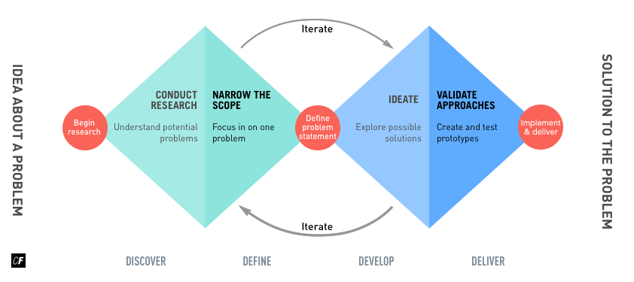
Using the Double Diamond Strategy

Slide 3
List of possible problems
How to reach the expert (lack of awareness)
How to ask the questions to expert
A confusing user interface containing too much information or illogical navigation
Lack of trust on Expert, before taking advice
Feel to pay an adequate amount of fees for advice
Unable to solve the issue by expert or user became unhappy by the provided service

Slide 4
Problem Statement
Users need a way to find the yoga expert, specialise in the Pre-natal and post-natal yoga, because they wish to have, it would be easily accessible, more convenient and with verities of experts.
We will know this to be true when we see how many users are using our app to find yoga expert by posting questions, rating to the app and at least 12 download per day.

Slide 5
Possible Solutions
“An app that allows women to find Yoga expert during pregnancy or for new moms.
These expert advice are priced affordably and can be done through virtually i.e. video calls or textual.
The interface will be simple and totally focused on prenatal and postnatal yoga expert guidance, removing all other distractions and offerings.”

